Slide 1
Models and Methods of Software Configuration
Management
Sami Ullah
BSCS-F19-M60 (Section B Morning)

Slide 2
What is Software Configuration Management?
◆ Definition:
In software engineering, software configuration management (SCM or S/W CM) is the task of tracking and controlling changes in the software, part of the larger cross-disciplinary field of configuration management. SCM practices include revision control and the establishment of baselines.
Description:
♦ Software Configuration Management encompasses the disciplines and techniques of initiating, evaluating and controlling change to software products during and after the software engineering process.

Slide 3
Literature Review
Ref# | Name | Author | Method | Conclusion
[1] | Software Configuration Management Patterns | Addison-Wesley, 2003 | Effective TeamWork, Practical Integration | Team work approaches practical integration of patterns
[2] | A Model-Driven Configuration Management System for Advanced IT Service Management | Giese, H., Seibel, A. and Vogel, T.,2009 | Defines models derived from management configuration | Derived models for advanced IT Service Management
[3] | Configuration Management Best Practices | Addison-Wesley, 2010 | Practical Methods that Work in the Real World | Providing methods that work in the real world.
[4] | A Configuration Management Task Ontology for Semantic Integration | Calhau R. and Falbo R., 2012 | Semantic Integration | describing the semantics of the data, providing a uniform way to enable communication by which different parties can understand, Logic and Proof
[5] | Advances in Release Management and Automation | Azoff, M.,2014 | Systems development life cycle (SDLC). | It ensures that release teams efficiently deliver the applications and upgrades accordingly.

Slide 4
Methodology
◆ We will define the following terms
Configuration Item
Baseline
SCM Directories
Version
Revision
Release
◆The definition of the terms follows the IEEE standard.
◆Different configuration management systems may use different terms.

Slide 5
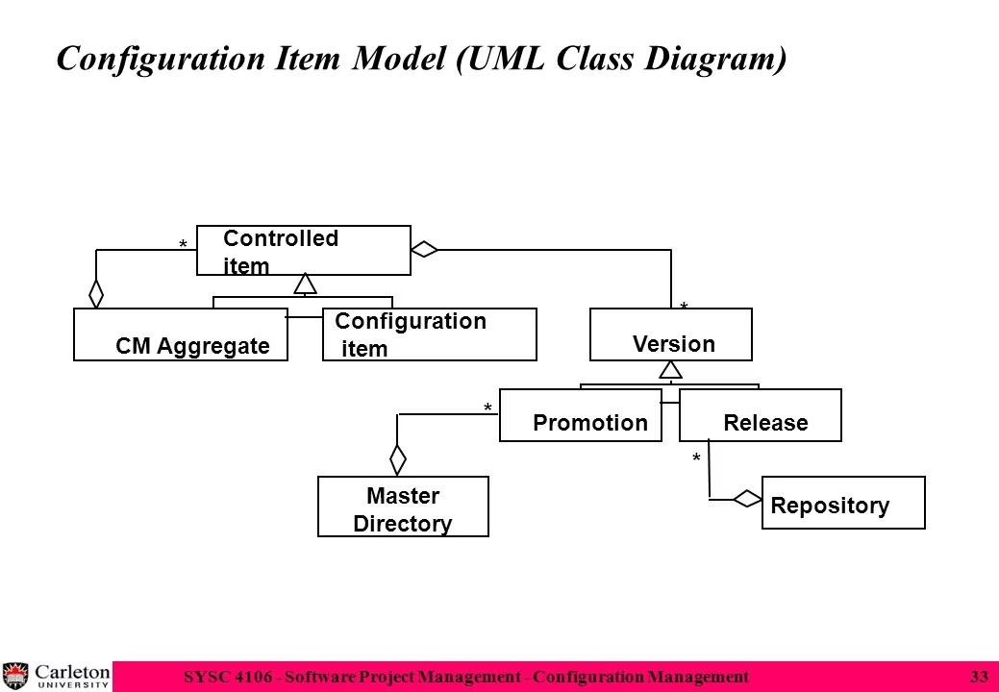

Slide 6
Discussion
Which of these Entities should be Configuration Items?
Problem Statement
Software Project Management Plan (SPMP)
Requirements Analysis Document (RAD)
System Design Document (SDD)
Project Agreement
Object Design Document (ODD)
Dynamic Model
Object model
Functional Model
Unit tests
Integration test strategy
Source code
API Specification
Input data and data bases
Test plan
Test data
Support software (part of the product)
Support software (not part of the product)
User manual
Administrator manual

Slide 7
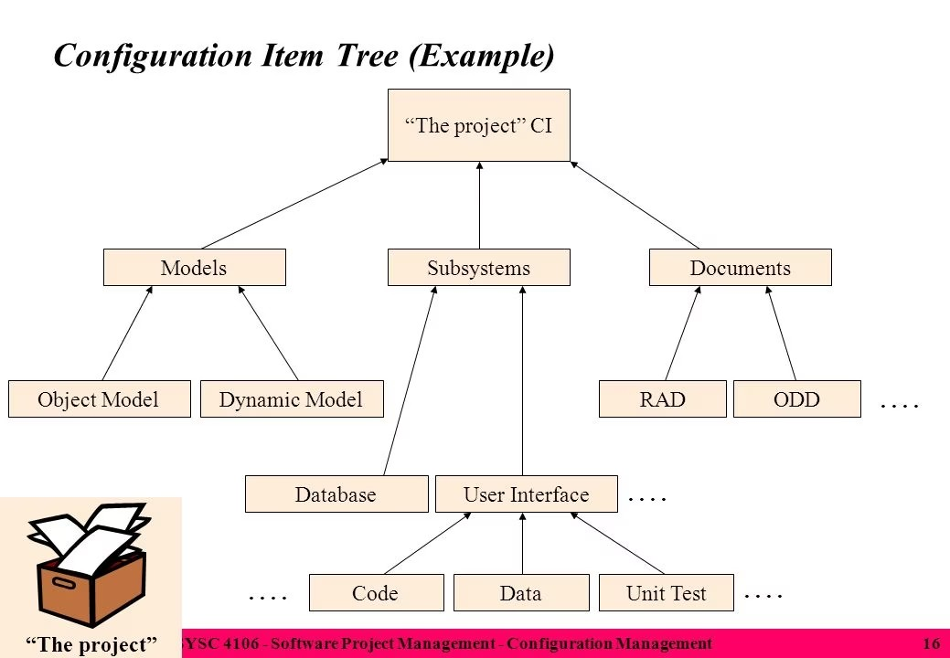

Slide 8
Conclusion
◆ Software Configuration Management: Important part of project management to manage evolving software systems and coordinate changes to them.
◆ Software Configuration Management consists of several activities:
Configuration Item
Baseline
SCM Directories
Version
Revision
Release
◆ Models of Software Configuration Management

Slide 9


